Slide 1
Guinea Proof of Concept –
Mojaloop Convening
October 2023

Slide 2
The Journey began, a year ago during… a Mojaloop Convening in Zanzibar

Slide 3

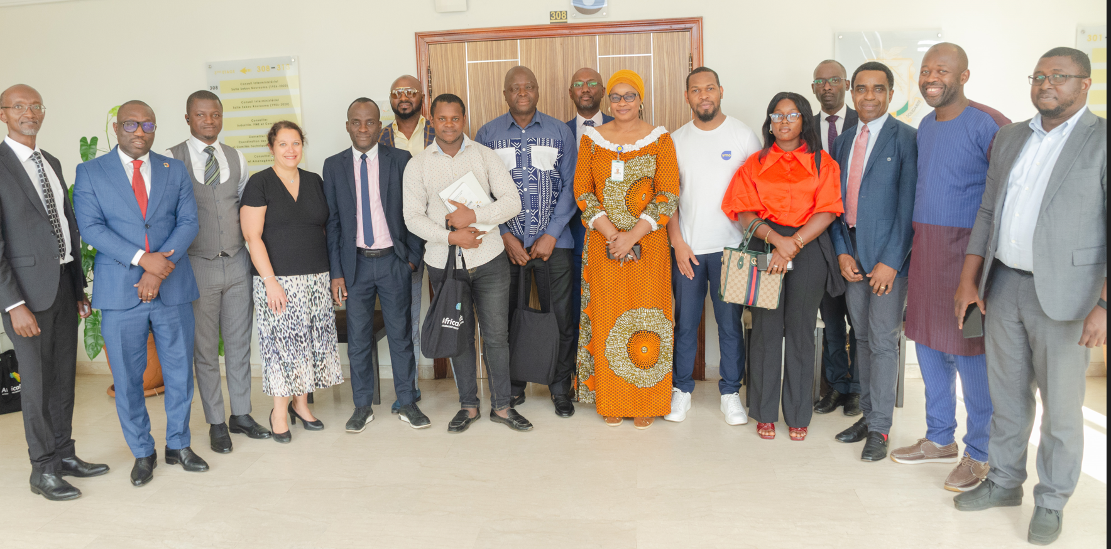
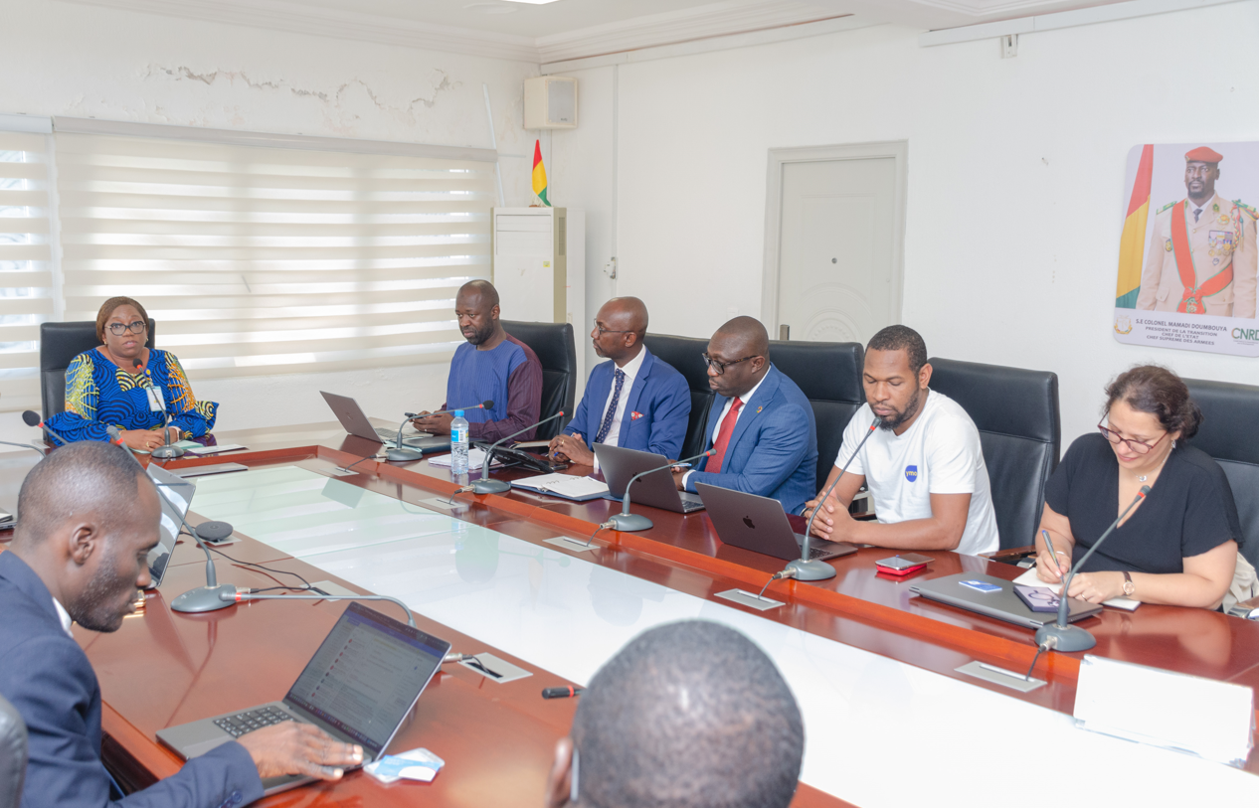
GUINEA – Status of engagement one year later...
Status:
Market readiness (diagnostic) executed
System Integrators engaged
PoC launched in September 2023
Accelerator program in preparation
Photos launch

Slide 4
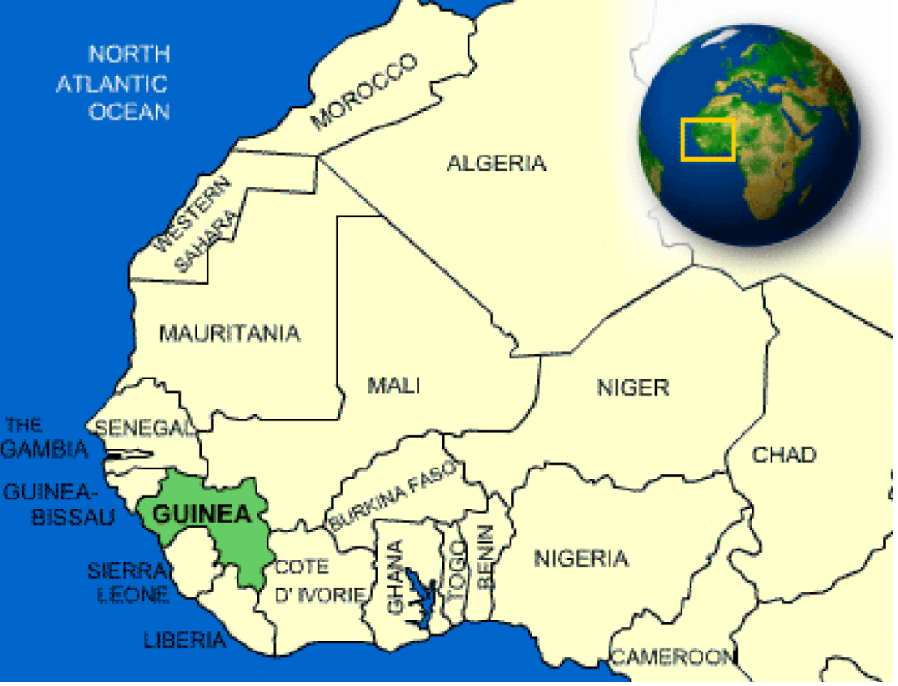
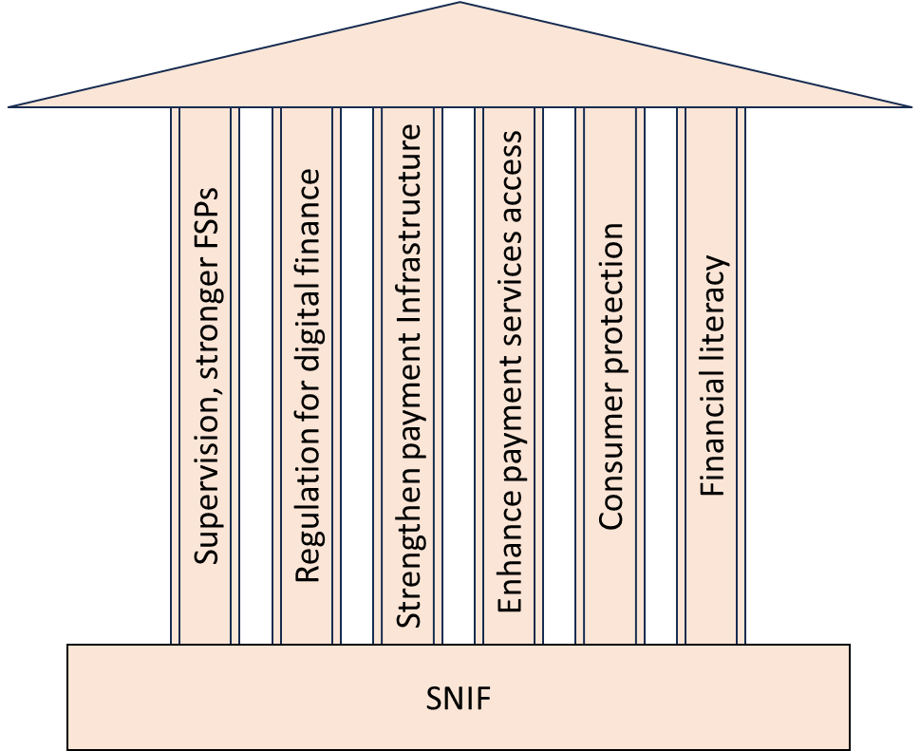
GUINEA - Country Summary
COUNTRY FACTS
8.1 M
Adult Population
5.64 M
Addressable market
20
Banks
3
MNOs
21
MFIs/Saccos
30.4%
Financial Inclusion Rate
Notes:
Map: "CountryReports" CountryReports. CountryReports, 2023. Web 23 Oct. 2023, https://www.countryreports.org/country/Guinea.htm
Strengthening the supervision of the Financial Institutions sector, improve bankruptcy prevention for a solid and sustainable financial sector;
Improving the regulatory framework for the development of digital finance;
Strengthening payment infrastructures;
Reducing constraints on access to services and improve supply;
Strengthening consumer protection to improve confidence in the financial system;
Strengthening the financial education of populations.

Slide 5
Objectives of the PoC
2. TECHNICAL ASSISTANCE /
CAPACITY BUILDING
Skilling up local System Integrators
through skill transfer during the project implementation
through an Accelerator Program
1. DEMO
Demonstrate interoperability of person to person transfers between different types of DFSPs
3. LEARNING AND PREPARATION
FOR SCALING
After the PoC, scale up using lessons learned to include more DFSPs and additional use cases

Slide 6
Brief Overview of the PoC
PIU
TECHNOLOGY
The participants
The Prime Minister’s Office/The Central Bank - BCRG ,
ThitsaWorks,/Technolyne,
AfricaNenda/ Fondation Mojaloop
Based on the DPI platform, Mojaloop, hosted in the cloud
SERVICES
DURATION
P2P transfers, between different participants, and for various types of accounts
5-6 months
Post PoC PHASE
PARTICIPANTS
Extension to include more DFSPs,
Integration of merchant and government payments,
Collaboration with more local system integrators
More: use cases, participants, SIs.
2 MFIs,
2 banks,
2 mobile money operators/fintechs
.

Slide 7
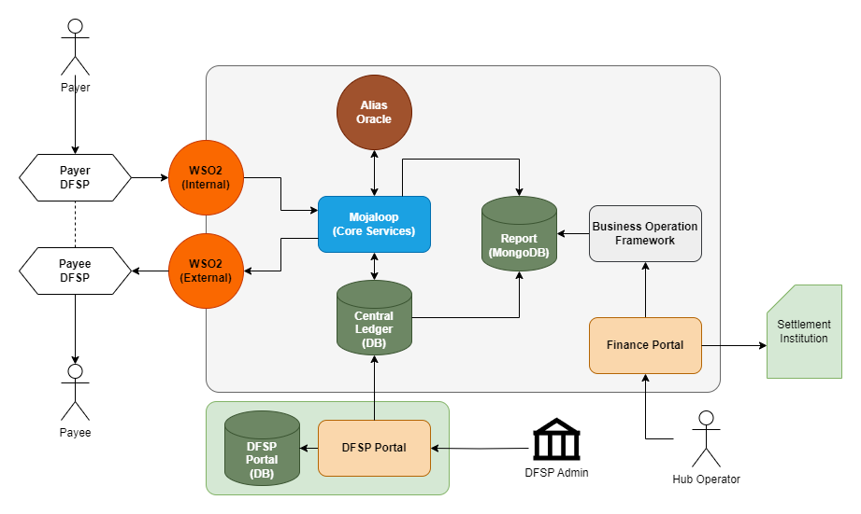
Technical Overview
Technical Overview
High-level Diagram of the Mojaloop Hub for POC

Slide 8
Project Phases & Completed Deliverables
Technical Overview
Training Local SI
Dependency on Local Hub Ops team & DFSPs
Training Local Hub Ops Team & DFSPs
(Payment Manager Portal, DFSP Portal, Settlement Process, Risk Management, Dispute Management)
Customization and reconfiguration of Directory
Dependency on DFSPs
Subsequent Onboarding
Dependency on DFSPs
Dependency on DFSPs
Phase 3 (Jan 2024 – Feb 2024): Monitoring Period

Slide 9
Next Steps
Technical Overview
Onboarding MMOs and MFIs - Fit for the Use Case of POC
Securing approval from Central Bank /PM’s office for DFSPs’ Participation
PM4ML & Core Connector Configuration
Onboarding Settlement Institutions & DFSPs
Testing
Customization & Maintenance
Final Demo
Migration of Hub Operation to the Designated Local Team
Development of Operational Processes, Procedures & Manuals
Training
Local Hub Ops Team & DFSPs

Slide 10
Challenges and Lessons
CHALLENGES AND LESSONS
CHALLENGES
LESSONS
Need for local partner or lead to drive stakeholder engagement with all participants in the ecosystem
Time it will take to integrate DFSPs
Central bank engagement is critical to mobilise and get DFSPs on board
Important to have successful reference sites for both PoC and live implementations
Growing focus and acceptance of DPGs/DPIs is addressing the questions around open source, security and sovereignty
Re-usable project resources (documents, templates, checklists, etc.) expedite turnaround time as well as speed of decision making and execution
01
02
Notes:
.

Slide 11

Questions

